Slide 1

Toronto Crime Analysis – CSI Toronto
Jaehong Kwon
XiongFei (Frank) Shi
Feng Wang
Olive Sun
Neha Nayeem

Slide 2


Project Description
As a newcomer to Toronto, I want to live in a safe and friendly neighborhood.
But,
How can I know which place is safer?
How should I locate those neighborhood?
How can I confirm if that place is always safe?

Slide 3

Process and Decision Making
Brainstorm ideas and factors on the investigation topic
Collect the data and discuss the feasibility within the team
Create master Git and allocate tasks to team members
Clean and combine datasets
Each team member finishes assigned task
Share and discuss observations in the team
Consolidate contributions to the master Git
Make modifications and finalize project
Final presentation

Slide 4

Our investigation targets
A) Most/least common types of crimes
B) Total # of crimes and trends
A) Seasonality of crimes
B) Frequency of crimes
A) Safest and Most Dangerous Neighborhood
B) Proximity to Police Stations
C) Occurrence pattern for specific type of crimes
Premises type for specific crimes
Correlation of crime with GDP
Notes:
RESEARCH QUESTIONS
a. What are the most common / least common crimes in Toronto?
b. What are the total number of crimes in 2014-2019 and are there any trends?
What time of the year the frequency of crime is highest?
Relationship between crime and different seasons
Relationship between crime and time of the day
Crime by neighborhoods
Which neighborhoods experience the highest and lowest crime rates in Toronto?
How close were police stations to where the crime occurred?
Where in Toronto are Auto Theft, Break and Enter and Robbery likely to occur?
In what kinds of properties do the following crimes occur? (house, commercial, apartment, etc)
Break-and-enter
Robbery
Assault
Is crime decreasing/increasing over the years?
Relationship between crime and current economy

Slide 5


Data Cleaning and Considerations
Data Cleaning
We used data from the crime data from Toronto Police Open Data.
We merged and reorganized data to include all major crime indicators (MCI), and keep columns which are necessary for our research.
We standardized information to a constant format.
Considerations
Unavailable dataset (the historical weather data)
Missing information in the raw dataset (the month and day occurred in homicide data)
Limitations of the economy data (monthly GDP growth rate)

Slide 6
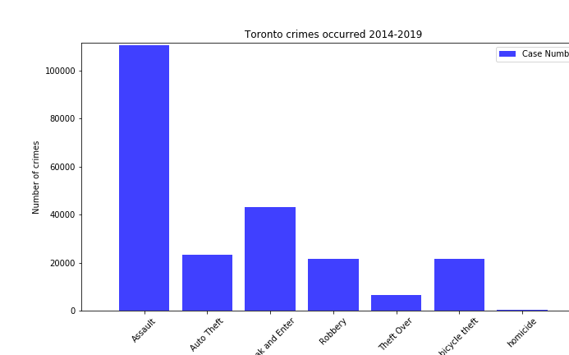
Toronto Crimes 2014~2019
Notes:
From 2014 to 2019, Assault is by far the most common crime with occurrences over 110,000, it accounts for 49% of total crimes. It is more than double the number of incidents for the second most common crime Break and Enter.
- Homicide is the least common crime over the 6-year period and only accounts for less than 0.5% of the total crime.

Slide 7
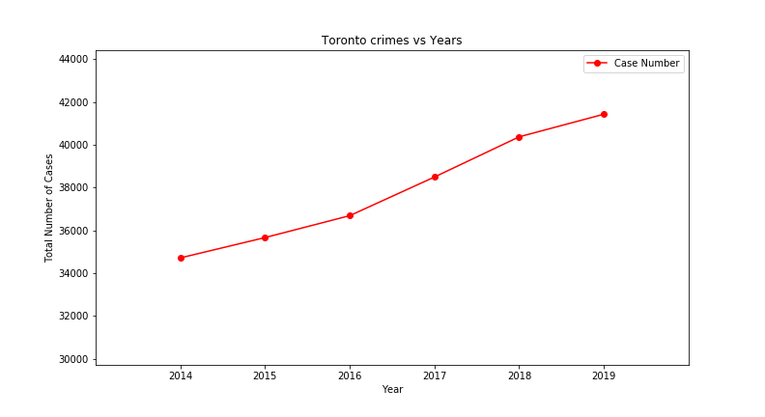
Toronto Crimes 2014~2019
Year | Total Number | Percentage Change
2014 | 34,710
2015 | 35,660 | 2.74%
2016 | 36,684 | 2.87%
2017 | 38,489 | 4.92%
2018 | 40,368 | 4.88%
2019 | 41,425 | 2.62%
Notes:
- The crime occurrence in Toronto is increasing from 2014 to 2019.

Slide 8
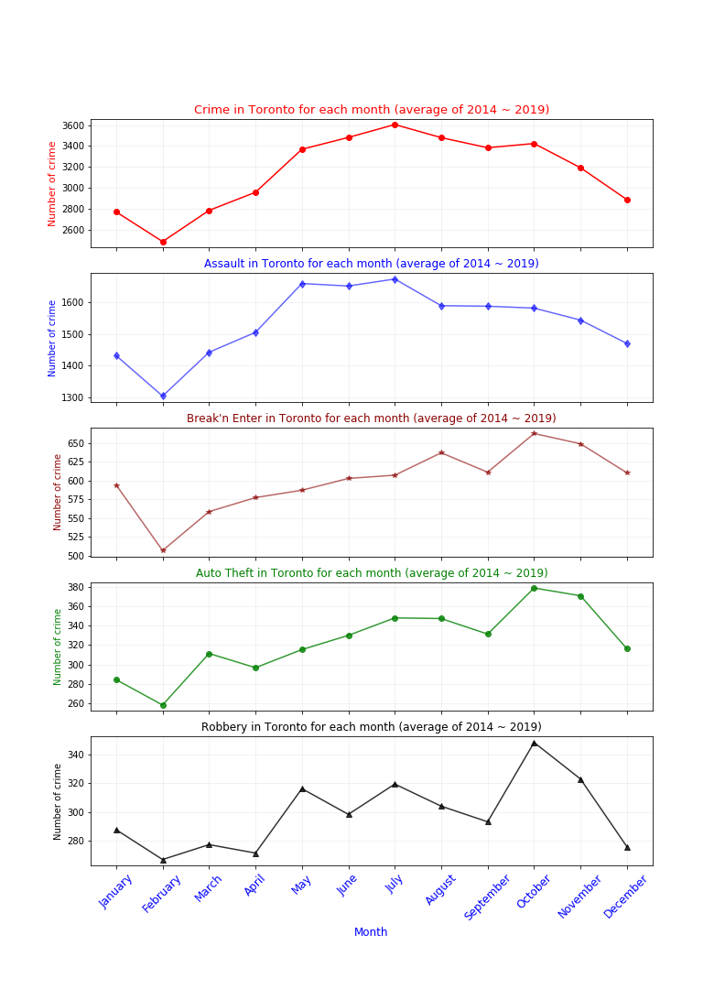
Seasonality of Crimes (aka Question 2A)
Notes:
Based on the 6-year average, the total number of crimes peak in the month of July (3606 cases) while the month of February is lowest (2,484 cases). There are more crimes in summer season then in winter season.
- Individual type of crime have different patterns. However, Feburary is the lowest point across all type of crimes.
- For Assault, the peak is in summer season (Jun, Jul, Aug). Break and Enter, Auto Theft, Robbery have peaks in October.

Slide 9
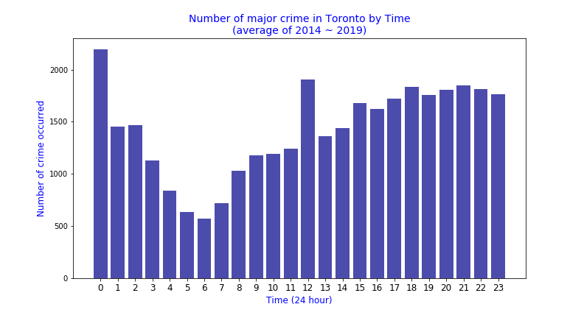
Frequency of Crimes (aka Question 2B)
Notes:
Lowest crime occurred in a day is early in the morning (around 6 am)
- "Assault" and "Break and Enter" crime occurred most at mid-night while "Auto Theft" is at peak around 10pm and "Robbery" at 9pm.
- At noon, we see a sudden spike for "Assault", "Break n Enter", "Auto Theft"

Slide 10
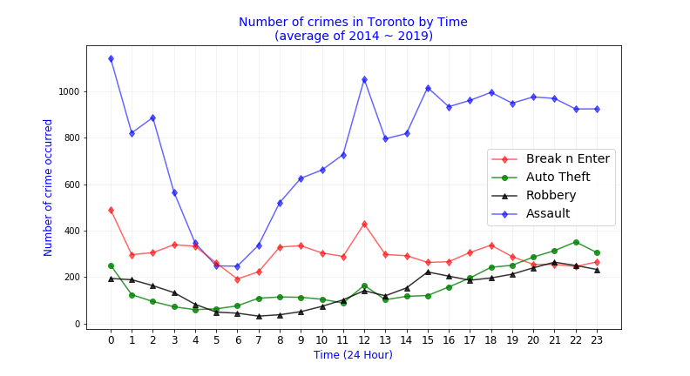
Frequency of Crimes (aka Question 2B)
Notes:
Lowest crime occurred in a day is early in the morning (around 6 am)
- "Assault" and "Break and Enter" crime occurred most at mid-night while "Auto Theft" is at peak around 10pm and "Robbery" at 9pm.
- At noon, we see a sudden spike for "Assault", "Break n Enter", "Auto Theft"

Slide 11
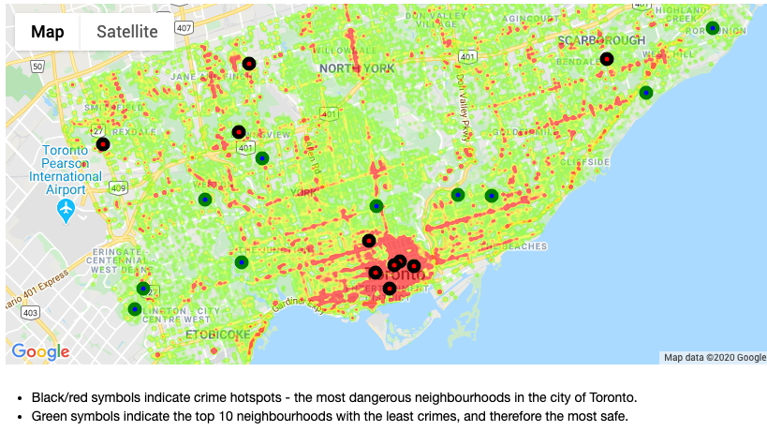
Neighborhood Investigation (aka Question 3A)
Notes:
- After analysing the data, we see the top 10 most dangerous neighbourhoods in the dataframe below:
![Most-crime-neighbourhoods](Image-Output/Most-crime-neighbourhoods.png)
- We also see the top 10 most safe neighbourhoods in the dataframe below:
![Least-crime-neighbourhoods](Image-Output/Least-crime-neighbourhoods.png)
- A heatmap was created with the above neighbourhoods as symbol markers, to get an idea of their locations:
![crime-heatmap-symbols](Image-Output/crime-heatmap-symbols.png)
* 60% of the top 10 most dangerous neighbours appear to be in the Toronto downtown area, with the rest spread quite far away from each other.
* The Yonge-St.Clair neighbourhood is considered a safe neighbourhood with less crimes - this is interesting given its proximity to downtown Toronto where crime cases are high.
* There appear to be a marginally higher number of safer neighbourhoods in the west end of Toronto.

Slide 12
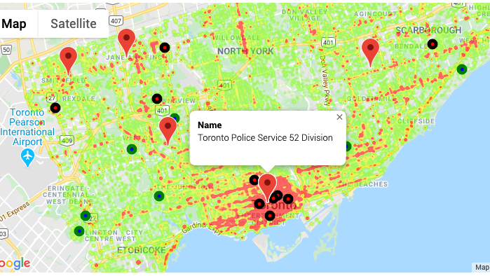
Neighborhood Investigation (aka Question 3B)
Notes:
Google Places API was called to find police stations within 5000m of the top 10 neighbourhoods and these were added as marker symbols on the heatmap:
![crime-heatmap-markers](Image-Output/crime-heatmap-markers.png)
- It appears that Toronto Police 52 Division is the nearest police station for 6 of the top 10 neighbourhoods with most crimes. This shows that the neighbourhoods are close to one another and also calls to question whether this particular division might be overwhelmed with crime incidents. It would be interesting to dive deeper and find out whether there is a correlation between crime rates and government funding for each police divisions.

Slide 13
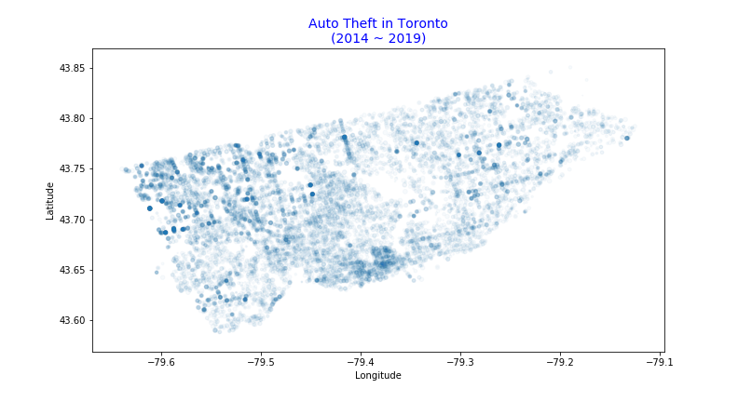
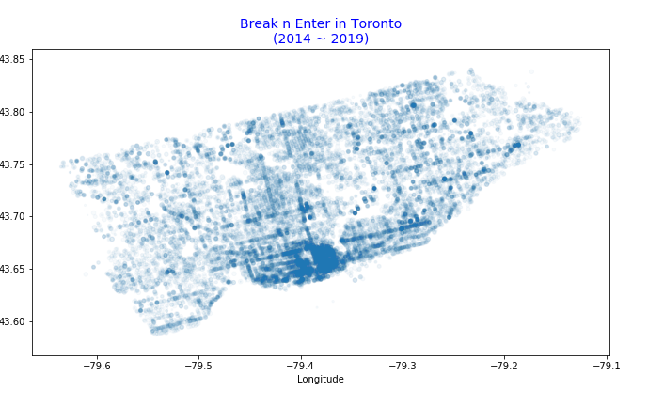
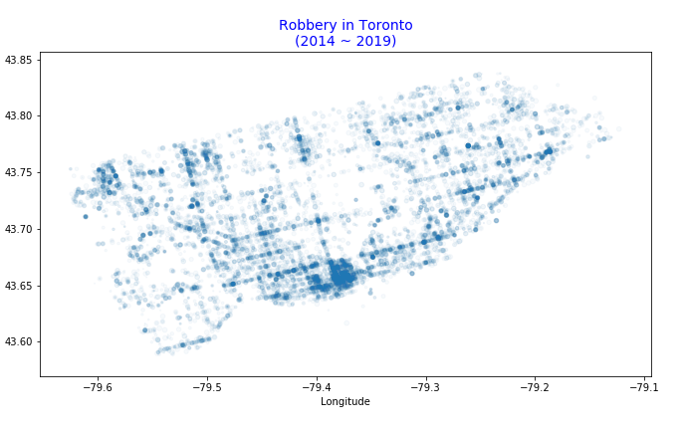
Neighborhood Investigation (aka Question 3C)
Notes:
Break and Enter and Robbery’s scatter pattern are consistent with the Toronto Crime Heat Map, they are most likely to occur in the most dangerous Downtown area. Auto Theft does not follow the same pattern and appeared to be scattered all over the city.

Slide 14
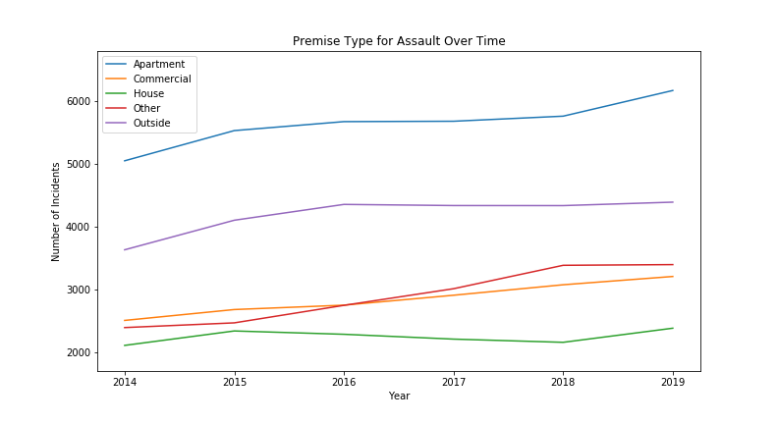
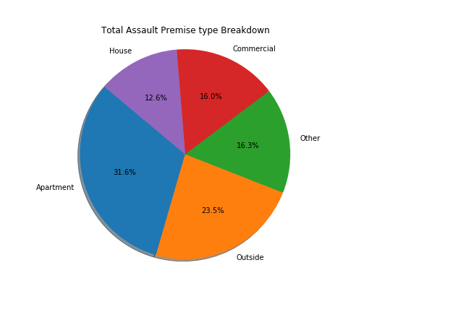
Premise Type Investigation (aka Question 4)
Assault
Notes:
- Assaults in all premises are generally in an increasing trend
- Assaults in apartments are most likely and is increasing at the highest rate
- Assaults are almost three times more likely to happen in apartments than in houses

Slide 15
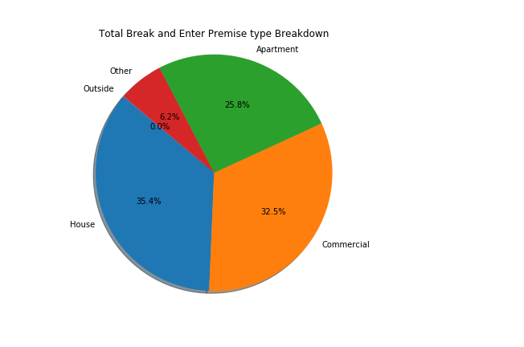
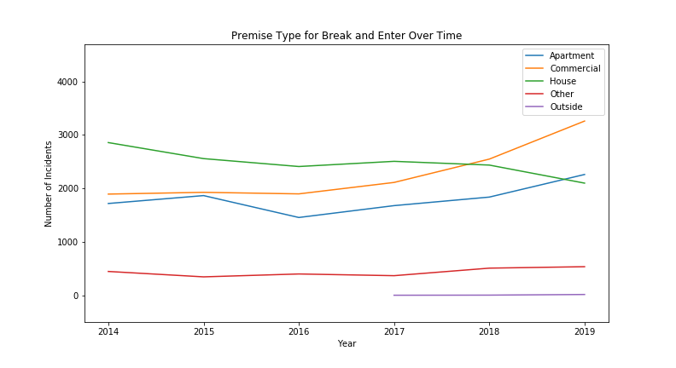
Premise Type Investigation (aka Question 4)
Break & Enter
Notes:
For Break and Enter (B&E), in 2014, there are almost twice the incidents happening in houses compared with Commercial or Apartment premises.
- However, House B&Es are decreasing over time while commercial B&Es are increasing. At the end of 2019, there are almost 1000 more B&E cases for commercial than houses
- There is a decrease in the number of incidents for apartments from 2015 to 2016 and this then started increasing at a steady rate since 2016, finally become more rampant than house B&Es.
- Even though House B&Es are decreasing over the years, the pie chart shows that it still has the highest total number of incidents.

Slide 16
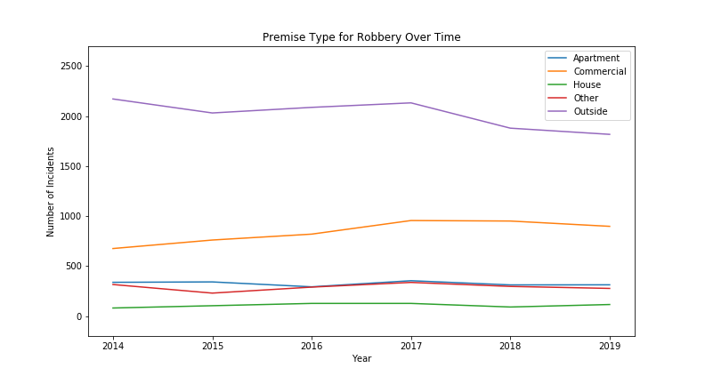
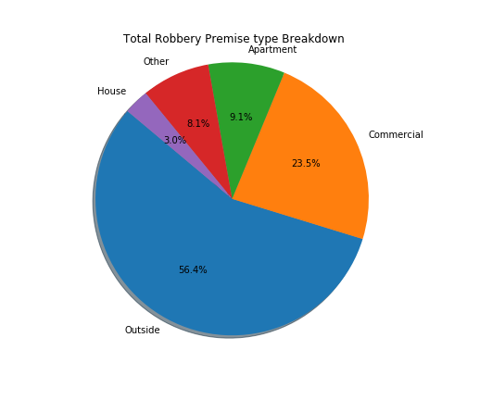
Premise Type Investigation (aka Question 4)
Robbery
Notes:
Incidents in apartment and houses are pretty steady over the six years.
- Majority of robberies happen outside and in commercial areas
- Robberies happening outside started to decrease from 2017, however, it is still twice as much incidents as the second popular premise-commerical by the end of 2019
- Robbery is three times more likely to happen in apartments than in houses

Slide 17
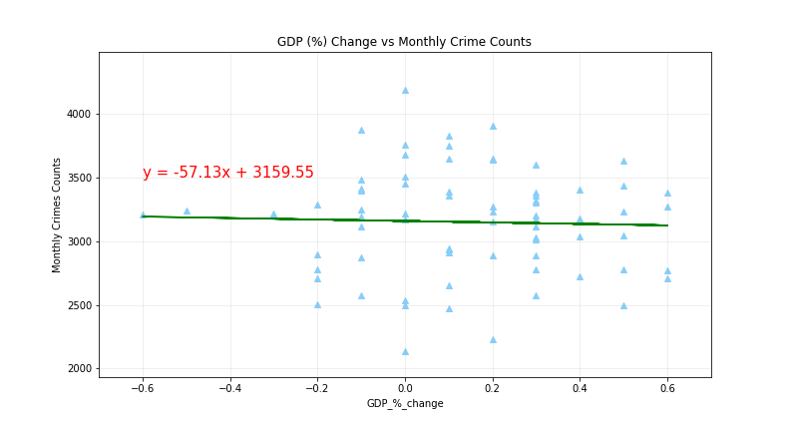
Relationship with GDP Growth Rate (aka Question 5)
Notes:
The number of crimes occurred in Toronto has weak correlation with GDP growth rate.
- The GDP has stable growth rate.

Slide 18

Summary
Most interesting part
Challenges
Future investigations
Things that need to improve
Limitations

Slide 19

Q&A

Slide 20

Thank you, next!

